Slide 1
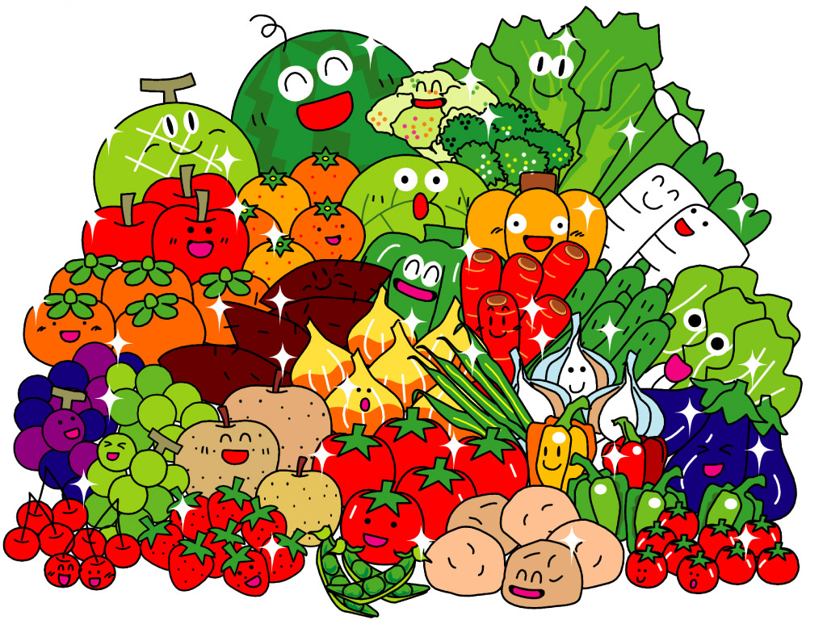
Unit Five Do you like pears?

Slide 2

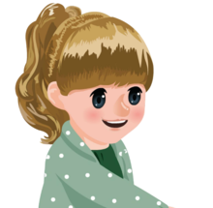

Slide 3

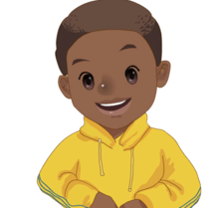

Slide 4
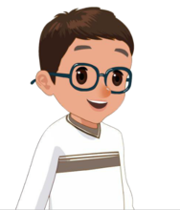

Slide 5
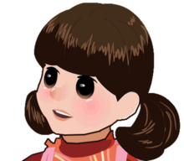

Slide 6
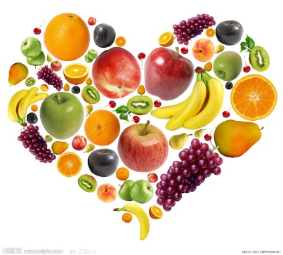
fruit party

Slide 7
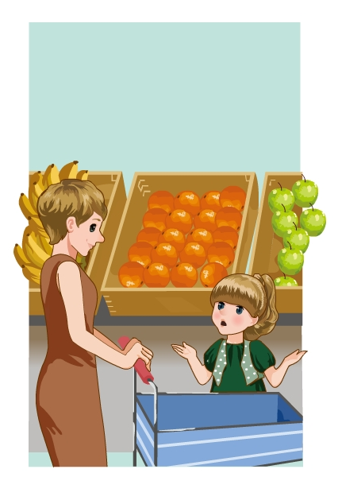
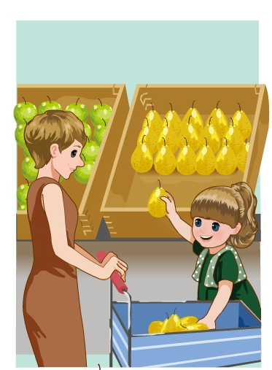
Sarah and her mother are buying(买)some fruit.

Slide 8
What does Sarah like?
What fruit do they buy?

Slide 9
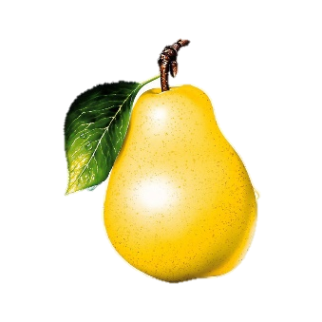
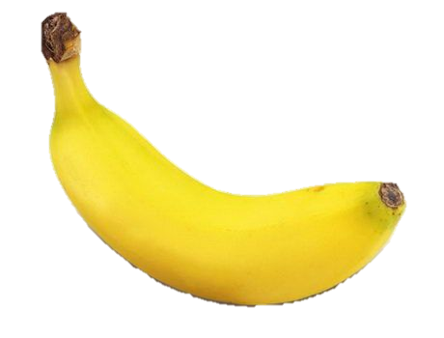
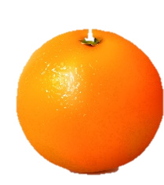
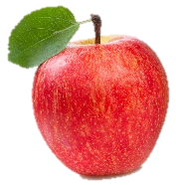
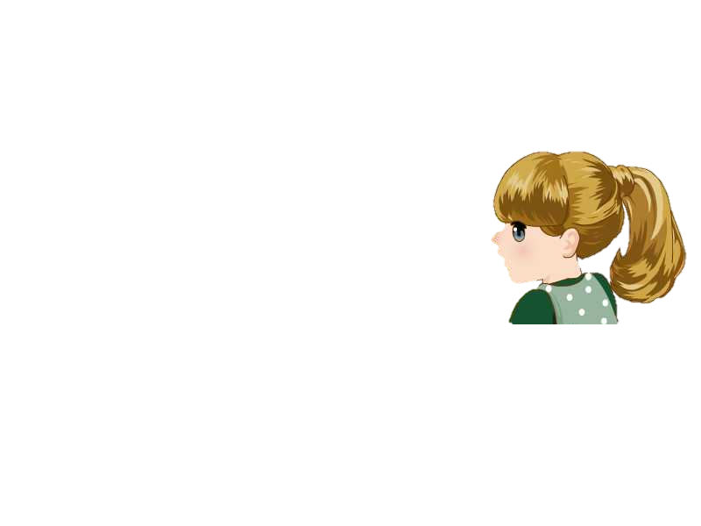
apples
oranges
pears
bananas

Slide 10
What fruit do they buy?
Honey, let’s buy some fruit. Do you like oranges?
Do you like pears?
Yes, I do.
No, I don’t.
I like apples.

Slide 11


Yes, I do.
No, I don’t.

Slide 12
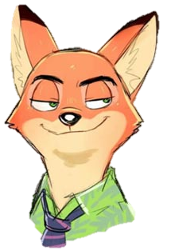
Do you like pears?

Slide 13
Do you like pears?
Yes, I do.

Slide 14
Do you like apples?

Slide 15
Do you like apples?
No, I don’t.

Slide 16
Do you like watermelons?

Slide 17
Do you like watermelons?
Yes, I do.

Slide 18
Do you like oranges?

Slide 19
Do you like oranges?
No, I don’t.

Slide 20
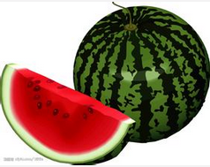
Thank you.
Happy birthday, Sarah. Here are the gifts.

Slide 21

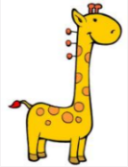

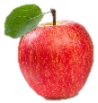
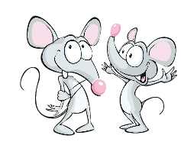
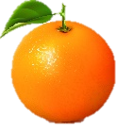

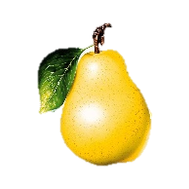

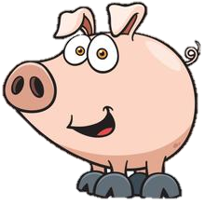
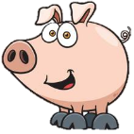

_________________
_________________
_________________
_________________
_________________
_________________
Do you like
_________________
_________________
_________________
_________________
_________________
…
Yes, I do. / No, I don’t.

Slide 22
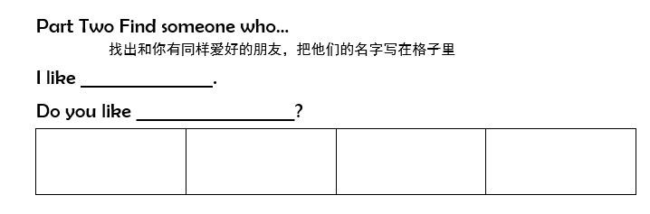

Slide 23
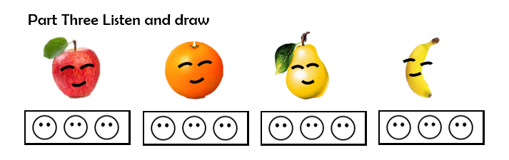
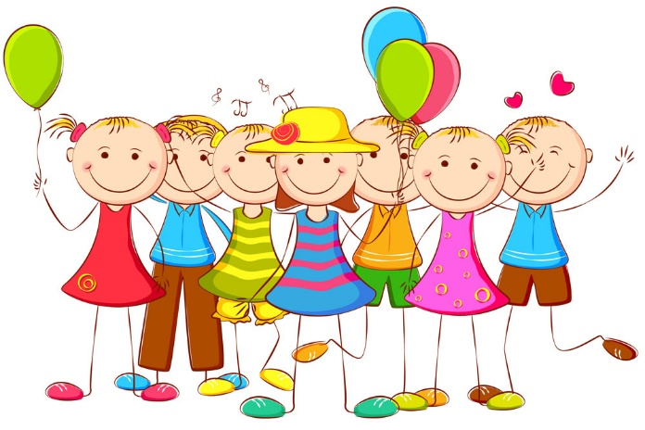
Do you like…?
Yes, I do.
No, I don’t.

Slide 24
Do you like apples?

Slide 25
Do you like apples?
One apple a day keeps the doctor away.
一日一苹果，医生远离我。

